Slide 1

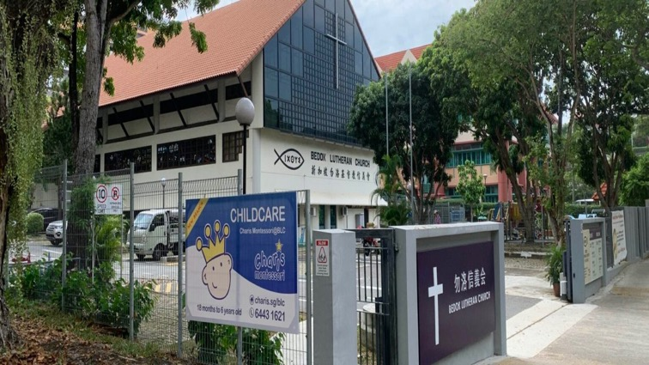
Welcome to Charis Montessori @ Bedok Lutheran Church
Entrance

Slide 2
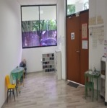
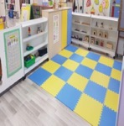
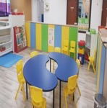


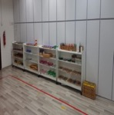
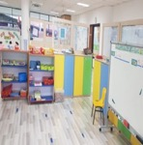
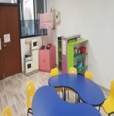

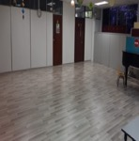
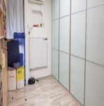


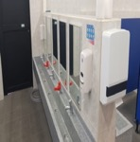
Entrance
Entrance
PG
N1
N2
Montessori Room
K2
K1
Music Room
Welcome to Charis Montessori @ Bedok Lutheran Church. Let me show you around
Sharing Room
Toilet

Slide 3
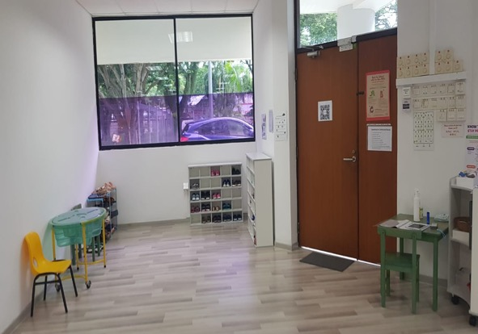
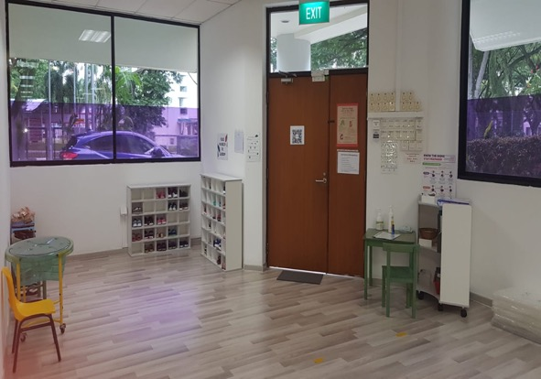

Entrance
This is where we conduct our health check and put our shoes
Directory
Our Entrance
PG

Slide 4
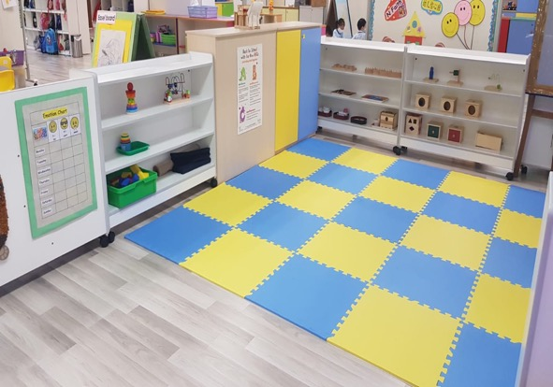
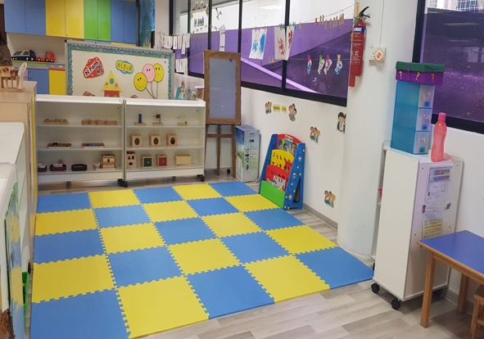
Entrance
Our cosy corner to learn and play
Directory
Entrance
Our PG Class
N1

Slide 5

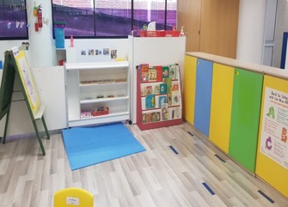
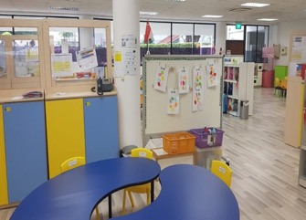
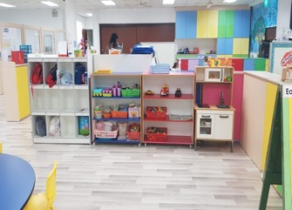
Entrance
I my reading corner !
Directory
PG
Our N1 Class
N2

Slide 6
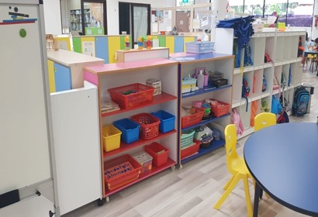
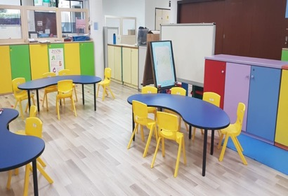
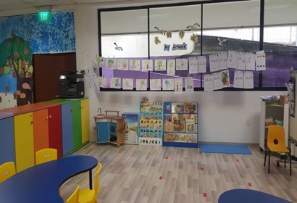
Entrance
I can easily find my art materials in my classroom
Directory
N1
Our N2 Class
K1

Slide 7

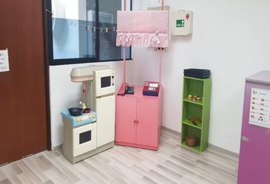
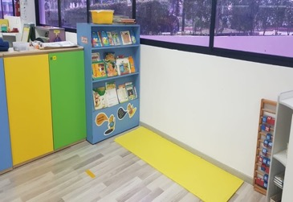
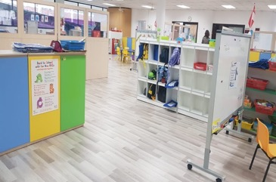
Entrance
I love the dramatic corner.
Directory
N2
Our K1 Class
K2

Slide 8
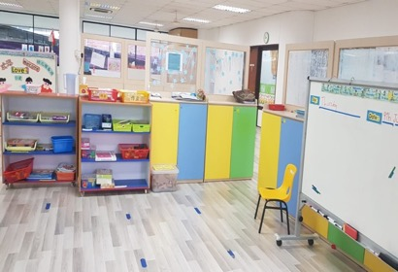
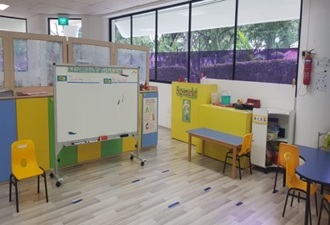
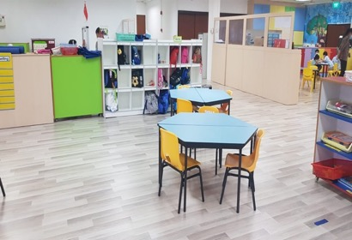
Entrance
I like to put on my thinking cap here and do my work with my friends
Directory
K1
Our K2 Class
Montessori Room

Slide 9
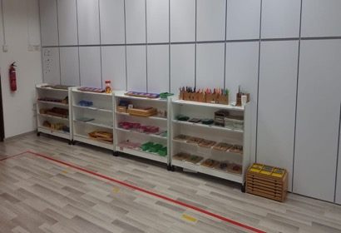
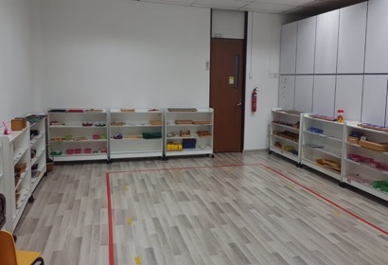
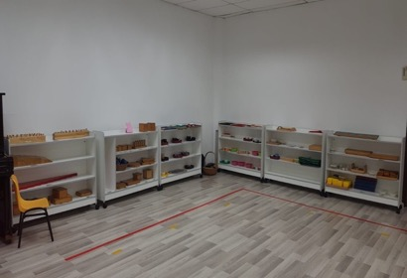
Entrance
I can learn Practical Life skills right here!
Directory
K2
Our Montessori Class
Music Room

Slide 10
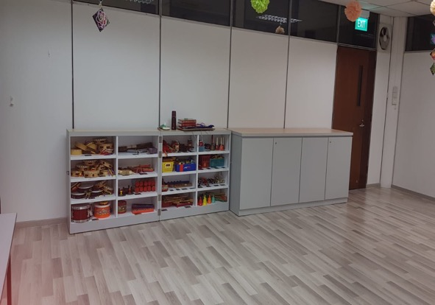


Entrance
My favourite musical instrument is the drum. How about you?
Directory
Montessori Room
Our Music Room
Sharing Room

Slide 11
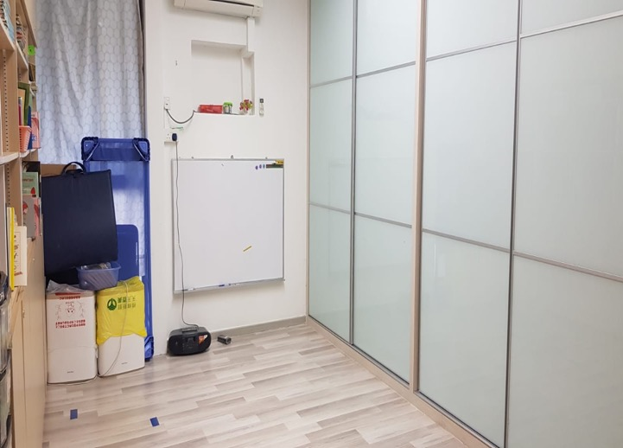
Entrance
This is where we share quiet time together
Directory
Music Room
Our Sharing Room
Toilet

Slide 12

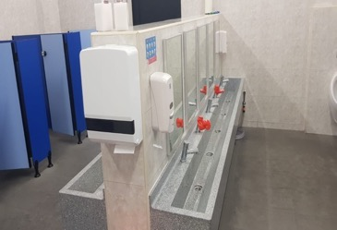
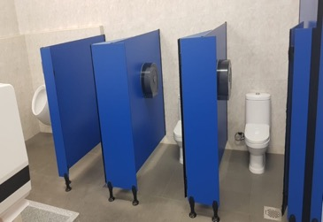
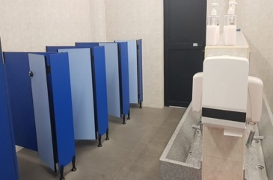
Entrance
This is where we clean ourselves up
Sharing Room
Our Toilet
Directory

